Slide 1
Computational Reproducibility in the Fragile Families Challenge
David M. Liu
Advised by: MAtthew J. Salganik
Notes:
Why did I do it?
Some social science journals, you are required to submit code. Wrapping in Docker ensured reproducibility
Active problem
Limits the effect of research
Goal that is easier to state

Slide 2
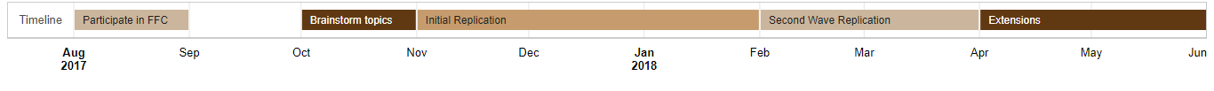
Overview of the Presentation
Background: Initial Involvement
Methodology: Replication Stack
Results: The Guidelines
Analysis: Costs of Reproducibility
Extension: Ensemble and Causal Inference

Slide 3
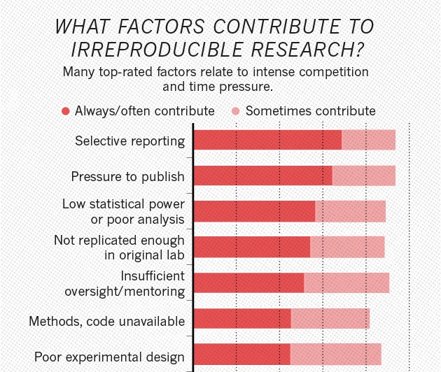
The Issue: Reproducibility Crisis
Replicable results are key to scientific findings
Nature survey finds that 70% of respondents have attempted and failed to replicate a study.
Particularly significant in Stats / ML
Data is large and noisy
Algorithms are stochastic
Findings dependent on hardware
Active, unsolved issue plaguing science

Slide 4
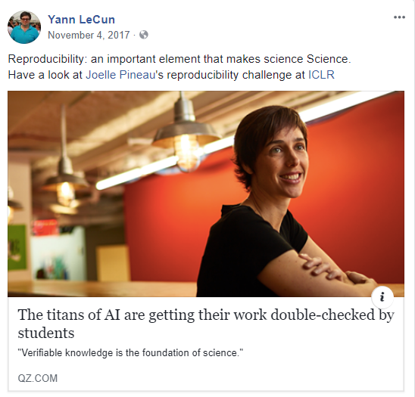
The Issue: Reproducibility Crisis

Slide 5

The Fragile Families Challenge
Basic Facts:
Longitudinal study behind Future of our Children
Kaggle-style predictive modeling challenge
February - July 2017
Attracted submissions from social and data science
COS 424
Notes:
What, Who, When

Slide 6
The Fragile Families Challenge
Basic Facts:
Longitudinal study behind Future of our Children
Kaggle-style predictive modeling challenge
February - July 2017
Attracted submissions from social and data science
COS 424
Main Question:
Can modern machine learning and statistical models be used for social prediction?
Notes:
What, Who, When
Not super helpful that COS 424 students were in the

Slide 7


Socius and Computational Reproducibility
FFC submissions → special edition of social-science journal Socius
Setting a new standard for reproducibility in the social sciences
Enhance the Challenge’s mission of collaboration
Effective contribution from computer science undergraduate
Notes:
The FFC is already fairly advanced, can we take it further?

Slide 8
The Authors

Slide 9
The Models
Feature Selection:
Lasso
Cross validation
Domain knowledge
None

Slide 10
The Models
Feature Selection:
Lasso
Cross validation
Domain knowledge
None
Imputation:
Amelia (R Package)
MICE
Naïve methods
Deletion

Slide 11
The Models
Feature Selection:
Lasso
Cross validation
Domain knowledge
None
Imputation:
Amelia (R Package)
MICE
Naïve methods
Deletion
Modeling:
Random Forest
GLM
Decision Trees
Neural Network

Slide 12
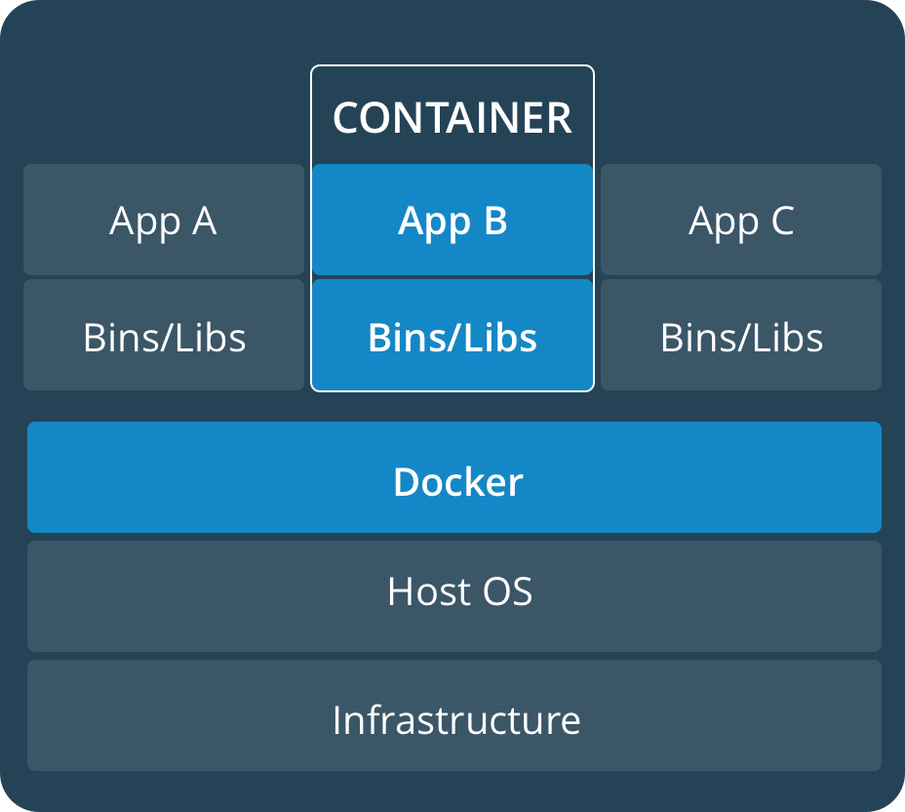
Docker
Software tool → research
Pros:
Lighter weight than virtual machines
Create a standardized environment
Strong open source community
Cons
Additional layer of between researcher and the code
Notes:
Read more into difference between docker and virtual machines

Slide 13
Reproducibility Work Flow
Read the Paper
Map Code to Paper
Build the Dockerfile
Aggregate dependencies and assemble file structure
Run
Troubleshoot
Relay with Author

Slide 14
Initial Challenges
Software Engineering
Concepts
Modularity
Abstraction
Portable
Maintainable
Practices
Quality Assurance
Test-Driven Development
Code Reviews
Computational Research
Goals
Result-Driven Development
Minimize error
Habits
Sharing data
Not expected to share code
Optimize for short term efficiency
Notes:
Work on visuals

Slide 15
Initial Challenges
Software Engineering
Concepts
Modularity
Abstraction
Portable
Maintainable
Practices
Quality Assurance
Test-Driven Development
Code Reviews
Computational Research
Goals
Result-Driven Development
Minimize error
Habits
Sharing data
Not expected to share code
Optimize for short term efficiency
Reproducibility
Notes:
Work on visuals

Slide 16
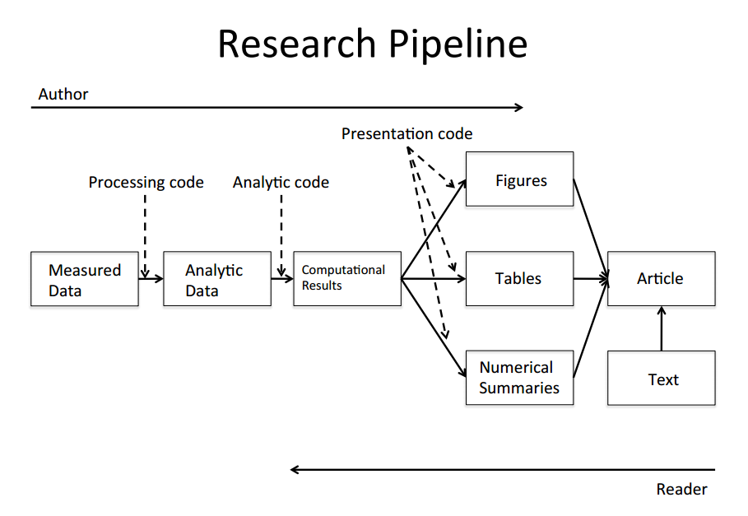
The Guidelines
A research pipeline:
Modular
Continuous
Automated
Two recommendations:
A run-all executable
Standardized directory structure
Supported by third-parties such as CodeOcean
Notes:
My advisor and I sat down to make sense of the challenges
Good time to connect software experience with social science setting

Slide 17
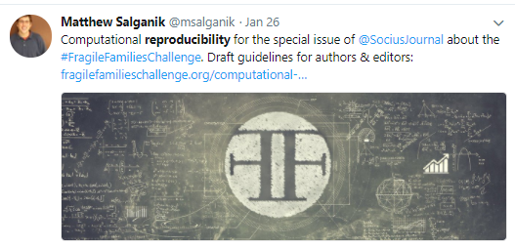
Implementation
January 2018: sent a reproducibility memo to all authors as part of the peer-review process
January – March: authors given two months to implement the guidelines.
Reproducibility guidelines
Notes:
Can somehow link to the memo itself as well as the blog post

Slide 18
Improvement
Authors have addressed bugs in the code
Submissions have been standardized in format
The models are executable and customizable.
Notes:
How to make this less anecdotal?

Slide 19
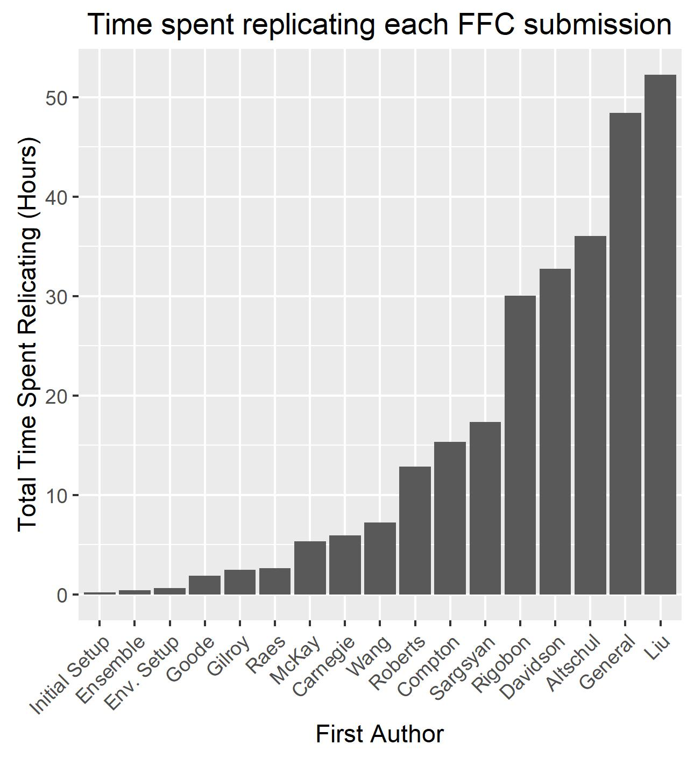
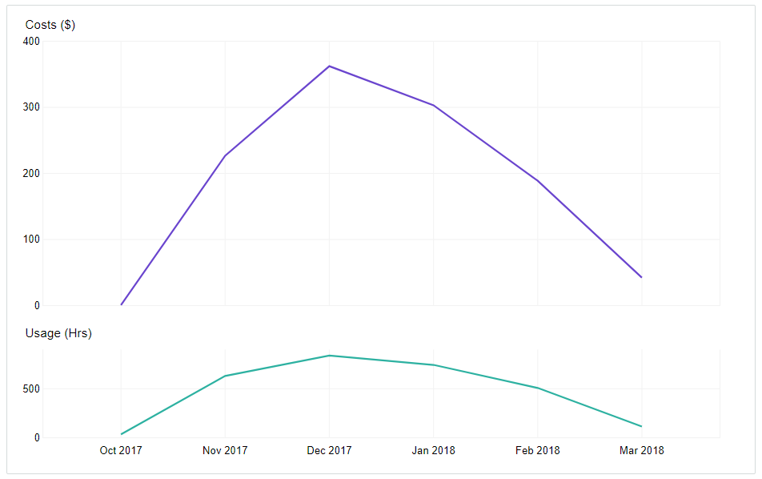
Cost of Reproducibility

Slide 20
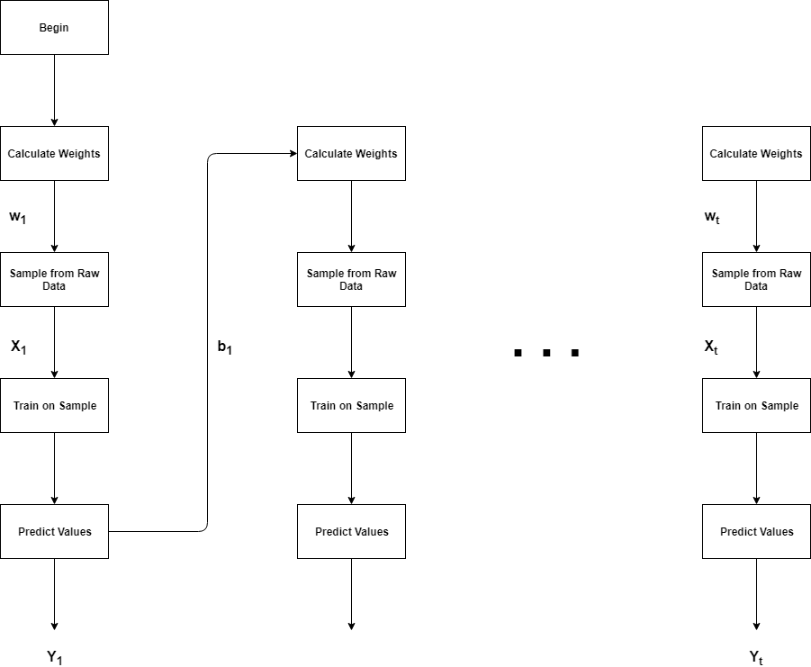
Final Steps and Future Work
Executing the models allows for applications:
Ensembling
Causal inference
Formalize guidelines into a research paper
Step in the direction of setting the norm.
Notes:
There is a wide range of priority placed in reproducibility
Come back to why the challenge was helpful. Set the model. Write a paper.

Slide 21
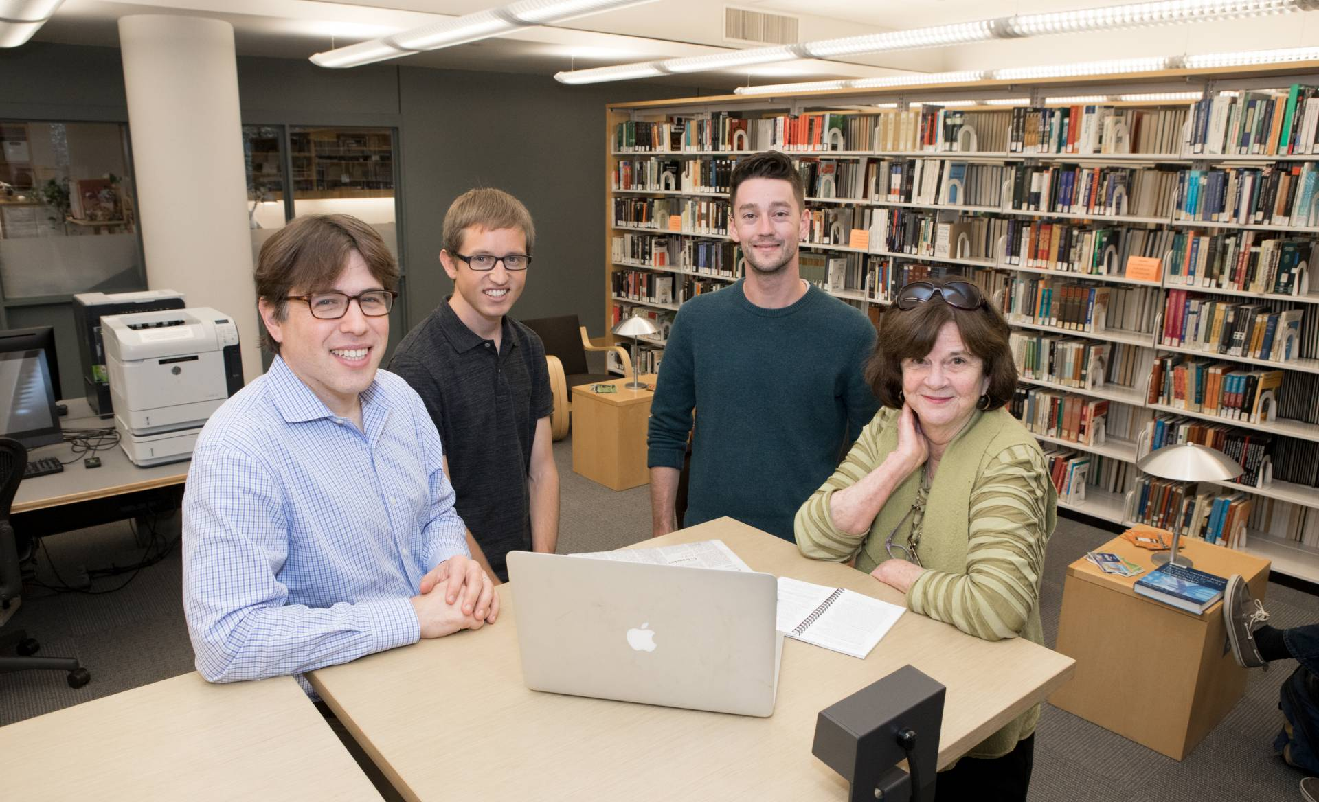
Acknowledgements
Matthew J. Salganik
The Fragile Families and Child Wellbeing Study:
Sara McLanahan, Ian Lundberg, and Alex Kindel

